Slide 1
石虎與貓的辨識
劉彥維，林怡瑄

Slide 2
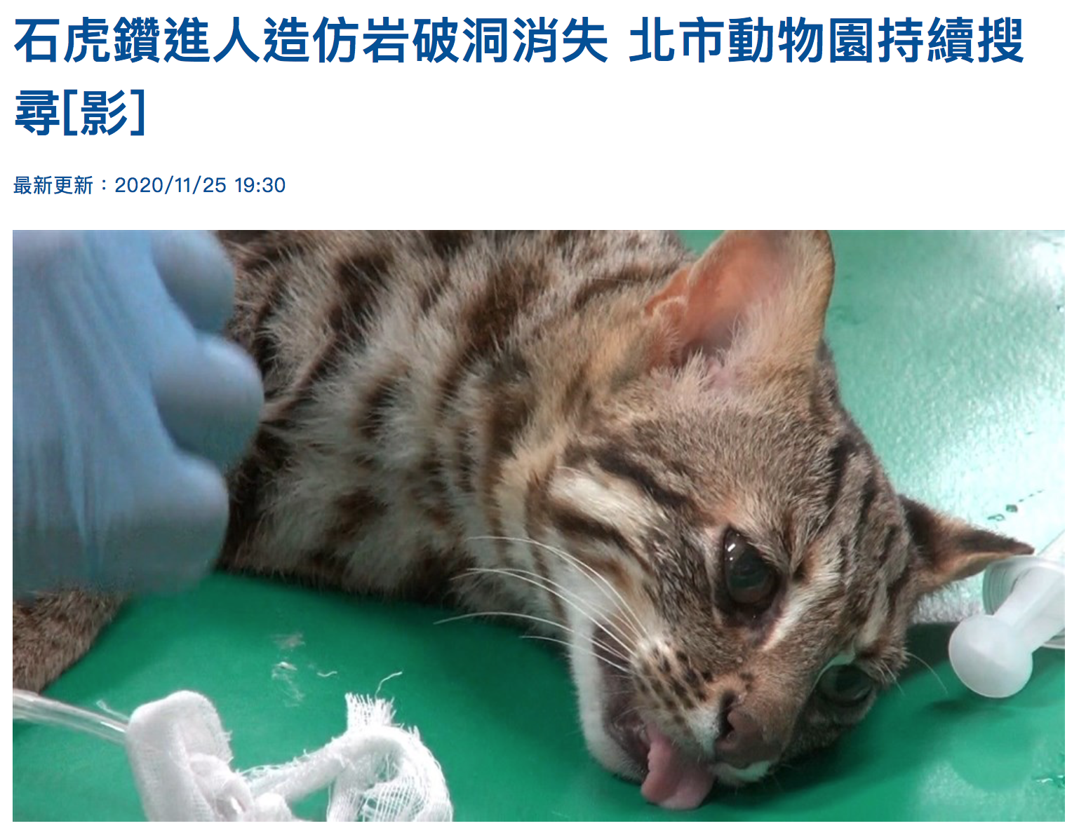

Slide 3
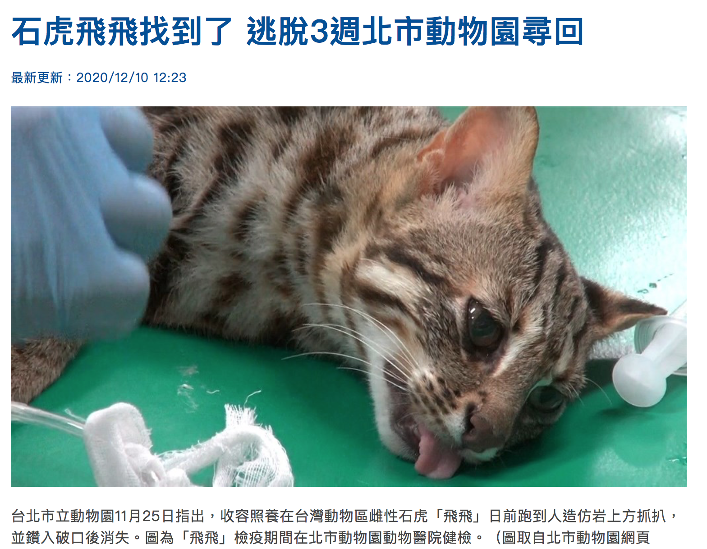

Slide 4
Results in Midterm Proposal
Training Ｍethod | Accuracy
SVM | 0.635
SVM (with Hyperparameter Search) | 0.638
MLP (with Hyperparameter Search) | 0.628
KNN (with Hyperparameter Search) | 0.655
Logistic Regression | 0.585
Random Forest | 0.652
Voting Classifier | 0.632
The Voting Classifier was combined with Logistic Regression, Random Forest, KNN,SVM

Slide 5
Solution
The above result comes with 64X64 image size. However, the result can’t meet our expectations. (at least 90%↑accuracy.)
We use bigger image size 256x256 as our input image.
Try other methods like CNN, Adaboost, etc.

Slide 6
Pipeline
Data Collecting
Data Pre-processing
Model Selection
Model Training
Model Evaluation

Slide 7
Data Pre-processing
All images collected from Flickr by web scraping technique.
We deleted some unrelated images manually.
Use Caesium to resize the images
Use AntRenamer to rename the image’s name

Slide 8
Final Dataset
431 images in 石虎(LeopardCat)
431 images in 貓(cat)
We use 80:20 split for training set and validation set

Slide 9
Results

Slide 10
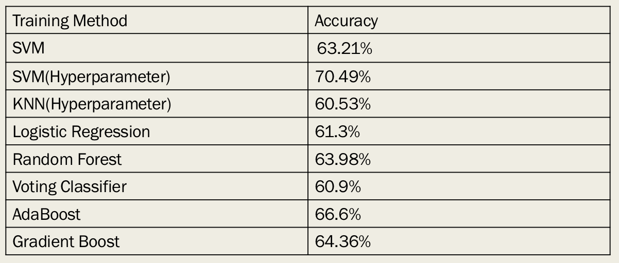
Result in 256x256

Slide 11
Improvement with CNN / CNN+SVM / CNN+XGBoost
Use CNN as feature extractor and then applying the feature to SVM and XGBoost
 | Accuracy
CNN | 74.71%
CNN+SVM | 77.58%
CNN+XGBoost | 78.61%

Slide 12
Original size -> 256x256
This time, we load the dataset without resizing in advanced.
After loading the dataset, we resize the original size to 256x256 with OpenCV
 | Accuracy
CNN | 71.84%
CNN+SVM | 70.11%
CNN+XGBoost | 75.86%
Note:
In previous experiments, we firstly resize all the images to the specific size(64x64 or 256x256) and then start our pipeline.

Slide 13
Pre-trained CNN Model

Slide 14
Resnet50

Slide 15
VGG16

Slide 16
InceptionResNetV2

Slide 17
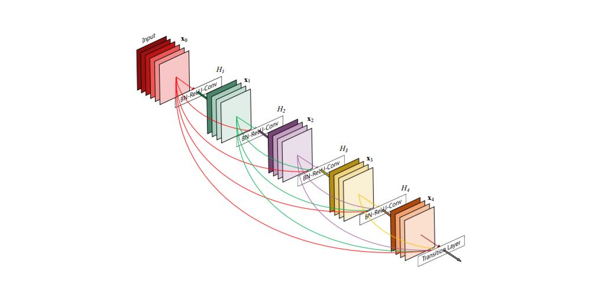
DenseNet201

Slide 18
Experiment Setting
Training with a NVIDIA TESLA V100 GPU from aiForge
Using Keras as our Deep Learning framework
EPOCHs = 50
BATCH SIZE = 32
Image size = 256 x 256
Learning rate = 0.0001

Slide 19
Results on Pre-trained CNN Model
 | Accuracy
Resnet50 | 91.36% 25,636,712
VGG16 | 92.08% 138,357,544
InceptionRexNetV2 | 94.96% 55,873,736
DenseNet201 | 96.4% 20,242,984
Parameters

Slide 20
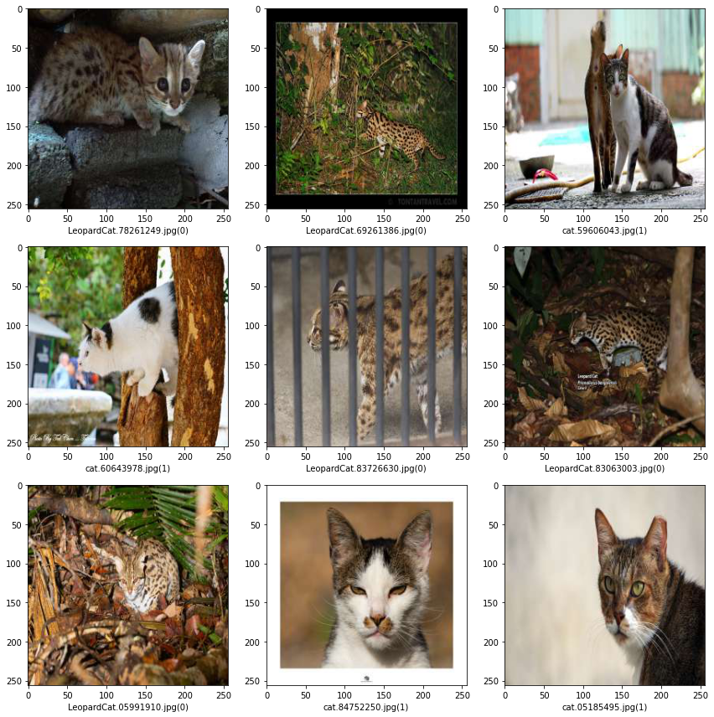
0：石虎(LeopardCat)
1：貓(cat)

Slide 21
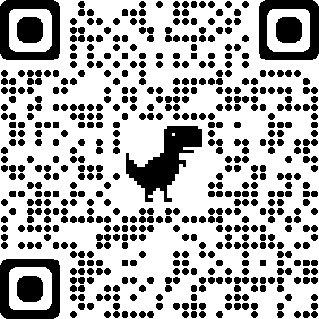
Source Code on GitHub
https://github.com/e96031413/ML_Term_Project

Slide 22
參考資料
[https://buzzorange.com/techorange/2019/09/03/leopard-cat-ai-conservation/]
[https://ourisland.pts.org.tw/content/%E5%8A%A9%E8%99%8E%E6%AD%B8%E5%B1%B1?fbclid=IwAR1mrYoZxmVLA325KwWXrrlsxBLLToH7yJxBg-eZwgynxFxyeLRKmAOqWA0]
[https://petsmao.nownews.com/20200820-114627]
[https://github.com/whimian/SVM-Image-Classification]
[https://www.kaggle.com/pandaqc/mlp-with-sickitlearn]
[https://towardsdatascience.com/how-voting-classifiers-work-f1c8e41d30ff]
[https://www.kaggle.com/matrixb/cnn-svm-xgboost/data?select=train]

